Slide 1
3D Basic & OpenGLES 2.0
thuy.vuthiminh@gameloft.com
phong.caothai@gameloft.com
khiem.tranthien@gameloft.com
tam.la@gameloft.com

Slide 2
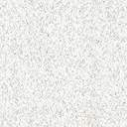
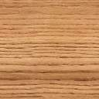
Content
Introduction
Rendering pipeline
Basic knowledge in Opengles 2.0?
Shader
Basic GLSL-ES
Basic Math
MVP matrices
Textures
NFG model
Shader effect: Skydome using cube mapping

Slide 3
Content
Introduction
Rendering pipeline
Shader
Basic GLSL-ES
Basic Math
MVP matrices
Textures
NFG model
Shader effect: Skydome using cube mapping

Slide 4
Basic Math
What is Texture?
Size of Texture
Text coordinate and Texel
Wrapping Modes
Filters
Mipmap
Coding
Textures concept

Slide 5
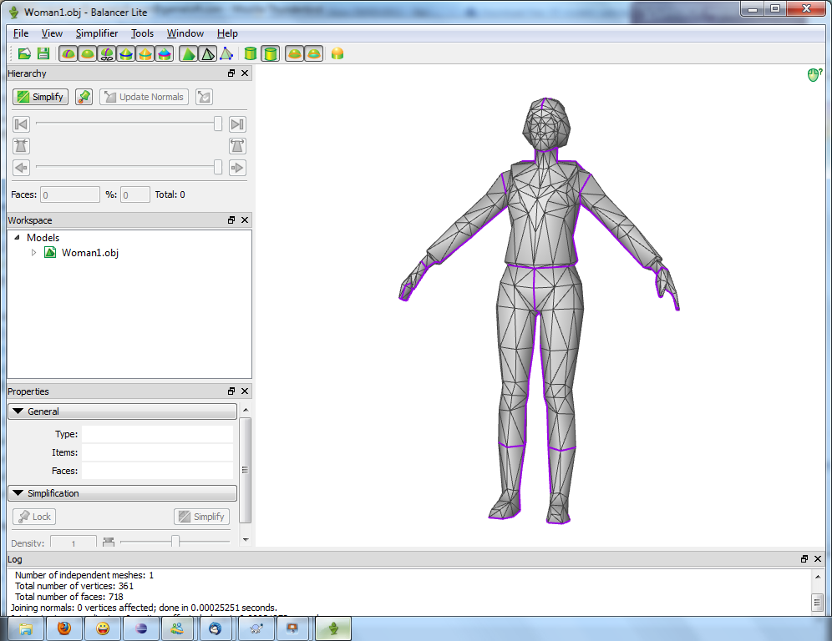
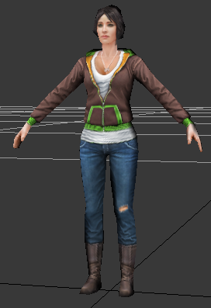
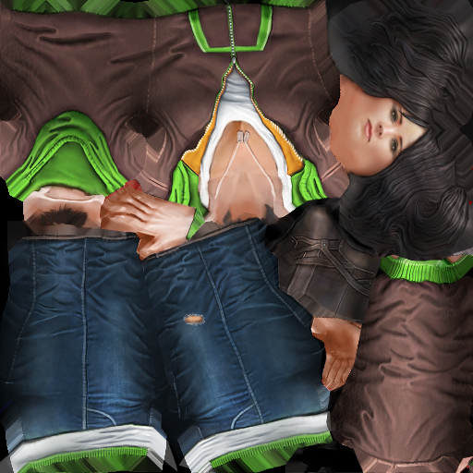
Textures
Texture is 2D Image applied on a 3D Object.
+
=

Slide 6
Textures
Each primitive on the 3D object will be map to a 2D Image
➔ Texture Mapping.
+

Slide 7

Size of Texture
Power of Two (POT):
Size (width, height) of a texture must be a power-of-two number, that mean it should be 1, 2, 4, 8, 16, 32, 64,….
None POT texture:
Some graphic cards support non-power-of-two textures.
For optimization and compatibility, we should use POT texture.
w
h

Slide 8
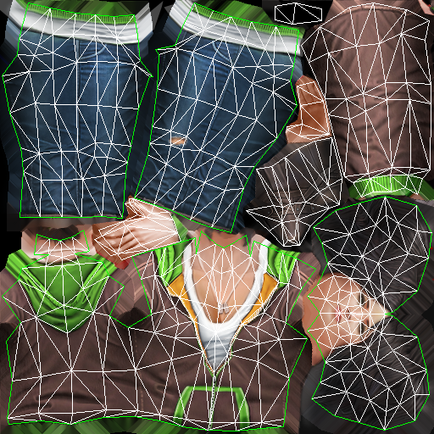
Text coordinate & Texel
UV or texture coordinate:
An attribute to describe the position of that vertex on the image
0, 0
u
Texel is a pixel on the texture.
T is a texel:
The coordinate of T on the image
Defined by (u, v)
The u, v is in [0, 1] range
v
T
1, 1

Slide 9

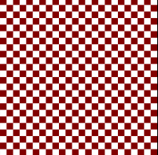

Wrapping Modes
Process to receive color on the image is called sampling
If pixel doesn’t receive a color by sampling, filling or mirroring the image depends on setting.
When UV is out of [0..1] range, to receive the color of that textel → options
glTexParameteri(GL_TEXTURE_2D, GL_TEXTURE_WRAP_S, wrap_s_option);
glTexParameteri(GL_TEXTURE_2D, GL_TEXTURE_WRAP_T, wrap_t_option);
Texture
WRAP_S: CLAMP
WRAP_T: CLAMP
WRAP_S: REPEAT
WRAP_T: REPEAT
WRAP_S: CLAMP
WRAP_T: REPEAT

Slide 10
Filters
u, v are float values
it is not always stay on a pixel in the image
→ we need a way to received the color from pixels on the images ?
→ Filters will solve this problems.
0, 0
u
v
T (u, v)
1, 1

Slide 11
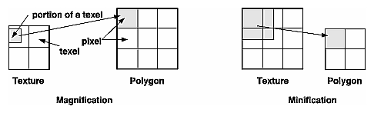
Filters: Minification and Magnification
Minification
More than one texel can cover a pixel
Magnification
More than one pixel can cover a texel
➔ Like when you zoom in/out the image, there must be a method to make the result.

Slide 12
Filters
Method to pick color from the texture with input u,v:
To set filtering options we use:
glTexParameteri(GL_TEXTURE_2D, GL_TEXTURE_MIN_FILTER, option);
glTexParameteri(GL_TEXTURE_2D, GL_TEXTURE_MAG_FILTER, option);
6 options:
GL_NEAREST: Nearest neighbor
GL_NEAREST_MIPMAP_NEAREST: Nearest neighbor with mipmapping
GL_LINEAR: Bilinear
GL_NEAREST_MIPMAP_LINEAR
GL_LINEAR_MIPMAP_NEAREST
GL_LINEAR_MIPMAP_LINEAR

Slide 13
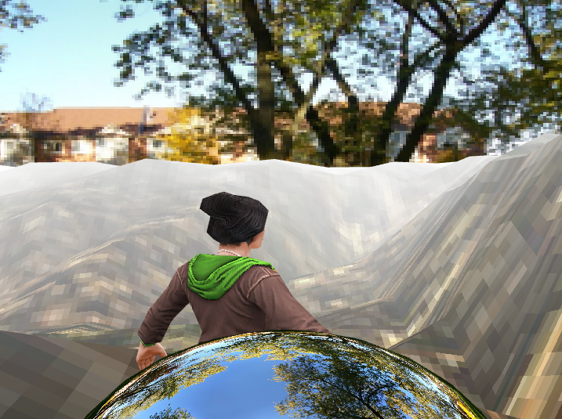
Filters
GL_NEAREST - Nearest neighbor: Pick the color of the nearest pixel on the texture image.
Fast method.
Generate a large amount of artifacts.
Pixel becomes big blocks in this scene
GL_NEAREST_MIPMAP_NEAREST - Nearest neighbor with mipmapping: Pick the color of the nearest pixel on the nearest mipmap:
Same to nearest neighbor but use mipmap.
Solve the antialiasing problem but we will still have blocks on our scene.

Slide 14
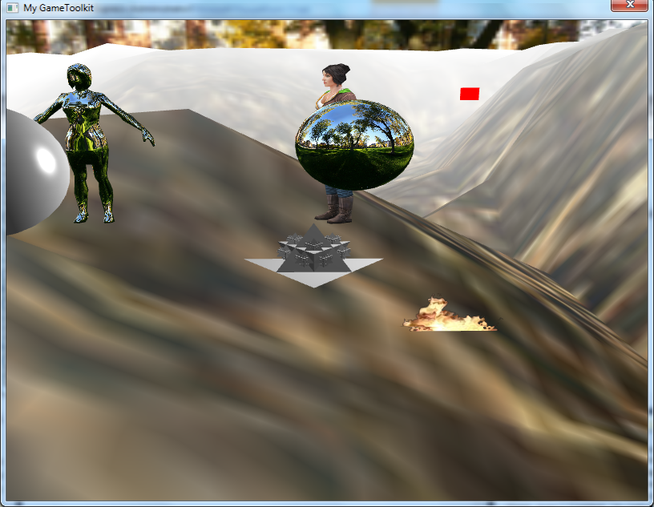
Filters (conts)
GL_LINEAR - Bilinear: Take four adjacent pixels to the texel to calculate the average color ➔ result color.
Notes:
- Vì cách generate mipmap bản thân nó đã solve vấn đề antialias.

Slide 15
Filter (conts)
GL_NEAREST_MIPMAP_LINEAR:
Take two adjacent texels on two nearest mipmaps by using GL_NEAREST, calculate the average value of the picked color → result color.
GL_LINEAR_MIPMAP_NEAREST:
Chose the nearest mipmap and use GL_LINEAR operation.
GL_LINEAR_MIPMAP_LINEAR:
Chose the two nearnest mipmaps to the texcel and pick the two texel using GL_LINEAR → calculate the average of those two values to get the final color.
Notes:
- Vì cách generate mipmap bản thân nó đã solve vấn đề antialias.

Slide 16
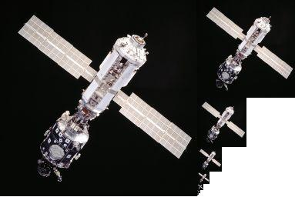
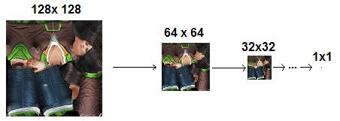
Mipmap
Mipmaps are pre-calcuated, optimized collection of image of a main texture
Advantages:
Increase rendering speed
Reduce anti-alias artifacts.
Lessens interpolation
Disadvantages:
Use much memory
Notes:
Tăng tốc độ xử lí là vì khi mimification -> xử lí với texture nhỏ hơn -> nhanh hơn.
Giảm răng cưa vì thuật toán tạo mipmaps đã có sẵn giảm hiệu ứng răng cưa.

Slide 17
Coding: How to use texture?
Writing the shader:
+ Add uv attribute.
attribute vec2 a_uv;
+ Add uv varying to pass it to the fragment shaders:
varying vec2 v_uv;
….
v_uv = a_uv;
+ Add uniform of the texture as a sampler2D.
uniform sampler2D u_texture;
+ Read the color value:
gl_FragColor = texture2D(u_texture, v_uv);
attribute vec4 a_position;
attribute vec2 a_uv;
varying vec2 v_uv;
void main()
{
gl_Position = a_position;
v_uv = a_uv;
}
uniform sampler2D u_texture;
varying vec2 v_uv;
void main()
{
gl_FragColor = texture2D(u_texture, v_uv);
}

Slide 18
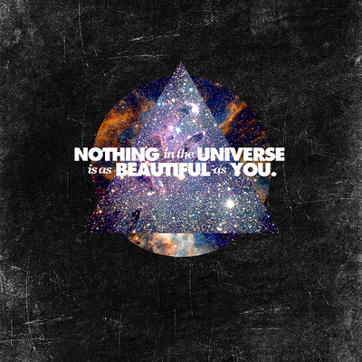
Coding (conts)
Define the Object and its attributes:
float vertices_pos[] = { … }; -> contain vertices array
float uv_pos[] = {…}; -> contailn texcoord array
Vertex attributes:
position.
uv.

Slide 19
Coding: How to use texture?
Generate the texture:
GLuint textureID;
glGenTextures(1, &textureID);
➔ A texture will be generated inside GPU.
Bind and load Texture data.
glBindTexture(GL_TEXTURE_2D, textureID);
char *imageData = LoadTGA(“source_file”,…);
glTexImage2D(GL_TEXTURE_2D, 0, GL_RGB, iWidth, iHeight, 0, GL_RGB, GL_UNSIGNED_BYTE, imageData);
➔ It depends on image data 24 bdp or 32 bdp we can use GL_RGB or GL_RGBA

Slide 20
Coding (conts)
Setting texture parameters:
glTexParameteri(GL_TEXTURE_2D,GL_TEXTURE_WRAP_S,GL_REPEAT);
glTexParameteri(GL_TEXTURE_2D,GL_TEXTURE_WRAP_T,GL_REPEAT);
glTexParameteri(GL_TEXTURE_2D,GL_TEXTURE_MIN_FILTER,GL_NEAREST);
glTexParameteri(GL_TEXTURE_2D,GL_TEXTURE_MAG_FILTER,GL_NEAREST);
Note: MIN_FILTER AND MAG_FILTER must be set to enable display texture
For mipmap texture only
glTexParameteri(GL_TEXTURE_2D, GL_TEXTURE_MIN_FILTER,
GL_NEAREST_MIPMAP_NEAREST );
// no GL_TEXTURE_MAG_FILTER with mipmap
glGenerateMipmap(GL_TEXTURE_2D);
We will have a texture inside the GPU for later use.

Slide 21
Coding (conts)
Setting the texture uniform:
glActiveTexture(GL_TEXTURE0);
glBindTexture(GL_TEXTURE_2D, textureID);
int iTextureLoc = glGetUniformLocation("u_texture");
glUniform1i(iTextureLoc, 0);
Command the GPU to draw the object:
glVertexAttribPointer(iVertexLoc, 3, GL_FLOAT, GL_FALSE, 0, vertices_pos);
glEnableVertexAttribArray(iVertexLoc);
glVertexAttribPointer(iTexcoordLoc, 2, GL_FLOAT, GL_FALSE, 0, uv_pos);
glEnableVertexAttribArray(iTexcoordLoc);
glDrawArrays(GL_TRIANGLES, 0, 3);
Note that: This code doesn’t use VBO

Slide 22
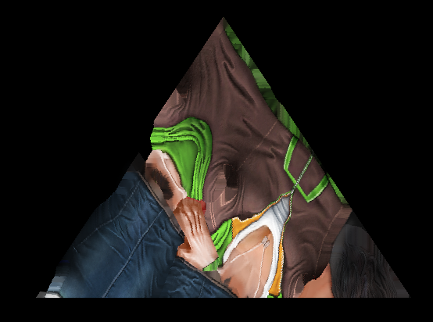
Texture: Practice
Draw a triangle and load texture into that triangle
Note: You must use VBO

Slide 23
Content
Introduction
Rendering pipeline
Shader
Basic GLSL-ES
Basic Math
MVP matrices
Textures
NFG model
Shader effect: Skydome using cube mapping

Slide 24

Model
3D models/geometries are typically comprised of
Polygons
Verticies
Textures
Normal
which create the model's shape.
Normally, using file format with obj, md2, md5,… file extension
Your current format in training is NFG

Slide 25
NFG File Format
Example: NrVertices: 512 0. pos:[0.134000, 1.020300, -0.083900]; norm:[0.662700, 0.317700, -0.678100]; binorm:[0.014559, 0.899869, 0.435830]; tgt:[-0.748718, 0.298721, -0.591766]; uv:[0.611900, 0.886700]; … 511. pos:[-0.326500, 1.214000, -0.008800]; norm:[0.727900, -0.637000, 0.253600]; binorm:[0.634562, 0.765975, 0.102637]; tgt:[-0.259692, 0.086258, 0.961831]; uv:[0.758900, 0.735100]; NrIndices: 2154 0. 0, 1, 2 1. 2, 3, 0 2. 4, 5, 6 ... 717. 480, 510, 509

Slide 26
NFG format
struct Vertex { Vector3 pos; Vector3 normal; Vector3 binormal; Vector3 tangent; Vector2 uv; };
Load each data into below structure:
Suppose N is number of vertices:
Vertex *vertices = new Vertex[n]; //n = 512 for this sample
Load for n vertices into structure
vertices[0].pos.x = 0.134000; vertices[0].pos.y = 1.020300; vertices[0].pos.z = -0.083900; ... vertices[0].uv.y = 0.611900; vertices[0].uv.y = 0.886700;

Slide 27
NFG format
Suppose NIndice is number of indices array. For this example, NIndice is equal to 2154.
The value of indices array will be:
Indices[Nindice] = {0, 1, 2, 2, 3, 0, 4, 5, 6,…, 480, 510, 509};
This means, to draw a woman model, we need 512 vertices, 718 faces, drawing in order by indices array with 2154 elements.

Slide 28
Content
Introduction
Rendering pipeline
Shader
Basic GLSL-ES
Basic Math
MVP matrices
Textures
NFG model
Shader effect: Skydome using cube mapping

Slide 29
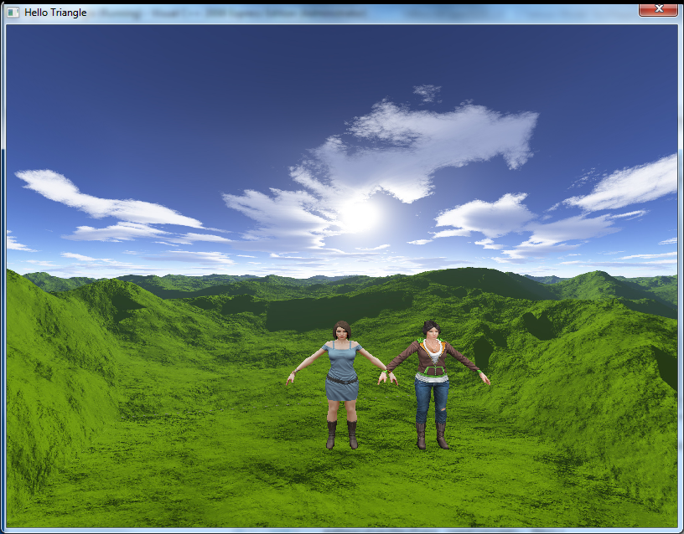
Skymapping: Sky dome
Called Cube mapping

Slide 30
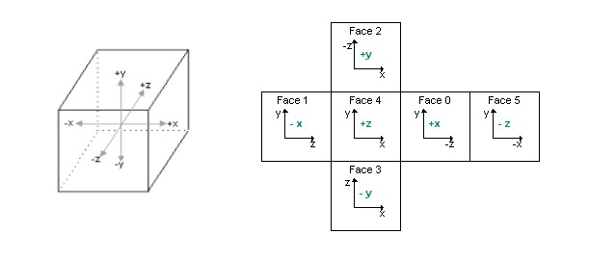
Sky mapping: Sky dome
An effect known as environment mapping
A cube (sky box) or a sphere (sky sphere) that encapsulate the whole scene composed of six 2D textures
A camera is placed in the center of the scene
Image 26 : Cube Map Unwrap

Slide 31
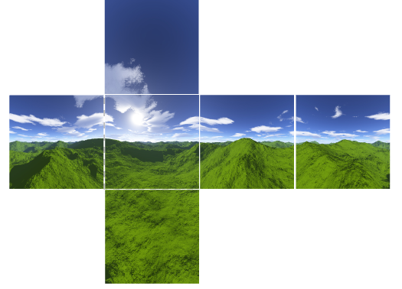
Sky mapping: Sky dome
A cubic texture included 6 sides of a cube
An image of the scene is captured from each of the six axis directions (+X, –X, +Y, –Y, +Z, –Z) and stored in each cube face
GL_TEXTURE_CUBE_MAP_POSITIVE_X,
GL_TEXTURE_CUBE_MAP_NEGATIVE_X, GL_TEXTURE_CUBE_MAP_POSITIVE_Y,
GL_TEXTURE_CUBE_MAP_NEGATIVE_Y, GL_TEXTURE_CUBE_MAP_POSITIVE_Z,
GL_TEXTURE_CUBE_MAP_NEGATIVE_Z

Slide 32
Sky mapping: Coding
Vertex Cube shader | Fragment Cube shader
attribute vec4 a_CubeVertexPos; uniform mat4 u_CubeMVPMatrix; varying vec4 v_pos; void main(void) { gl_Position = u_CubeMVPMatrix * a_CubeVertexPos; v_pos = a_CubeVertexPos; } | precision mediump float; uniform samplerCube u_samplerCubeMap; varying vec4 v_pos; void main(void) { gl_FragColor = textureCube( u_samplerCubeMap, v_pos.xyz); }

Slide 33
Coding (conts)
Official way | Optimized way
// Generate a texture object glGenTextures(1, &textureId); // Bind the texture object glBindTexture(GL_TEXTURE_CUBE_MAP, textureId); // Load the cube face - Positive X glTexImage2D(GL_TEXTURE_CUBE_MAP_POSITIVE_X, 0, GL_RGB, 512, 512, 0, GL_RGB, GL_UNSIGNED_BYTE, &cubePixels[0]); // Load the cube face - Negative X glTexImage2D(GL_TEXTURE_CUBE_MAP_NEGATIVE_X, 0, GL_RGB, 512, 512, 0, GL_RGB, GL_UNSIGNED_BYTE, &cubePixels[1]); // Load the cube face - Positive Y glTexImage2D(GL_TEXTURE_CUBE_MAP_POSITIVE_Y, 0, GL_RGB, 512, 512, 0, GL_RGB, GL_UNSIGNED_BYTE, &cubePixels[2]); // Load the cube face - Negative Y glTexImage2D(GL_TEXTURE_CUBE_MAP_NEGATIVE_Y, 0, GL_RGB, 512, 512, 0, GL_RGB, GL_UNSIGNED_BYTE, &cubePixels[3]); // Load the cube face - Positive Z glTexImage2D(GL_TEXTURE_CUBE_MAP_POSITIVE_Z, 0, GL_RGB, 512, 512, 0, GL_RGB, GL_UNSIGNED_BYTE, &cubePixels[4]); // Load the cube face - Negative Z glTexImage2D(GL_TEXTURE_CUBE_MAP_NEGATIVE_Z, 0, GL_RGB, 512, 512, 0, GL_RGB, GL_UNSIGNED_BYTE, &cubePixels[4]); | // Generate a texture object glGenTextures(1, &textureId); glBindTexture(GL_TEXTURE_CUBE_MAP, textureId); for (int i=0; i<6; i++) { glTexImage2D ( GL_TEXTURE_CUBE_MAP_POSITIVE_X+i, 0, GL_RGB, 512, 512, 0, GL_RGB, GL_UNSIGNED_BYTE, &cubePixels[i] ); }

Slide 34
Sky mapping: Coding (conts)
glBindTexture (GL_TEXTURE_CUBE_MAP, textureId); glEnableVertexAttribArray ( iPosVertexLoc ); glVertexAttribPointer (iPosVertexLoc, 3, GL_FLOAT, GL_FALSE, 0, m_aVerticesArray); glDrawArrays (GL_TRIANGLES, 0, 36);

Slide 35
Any question?

